Slide 1
Robust Contour Discovery for Plan Bouquets
Achint Chaudhary
MTech
Advisor
Prof. Jayant R. Haritsa

Slide 2
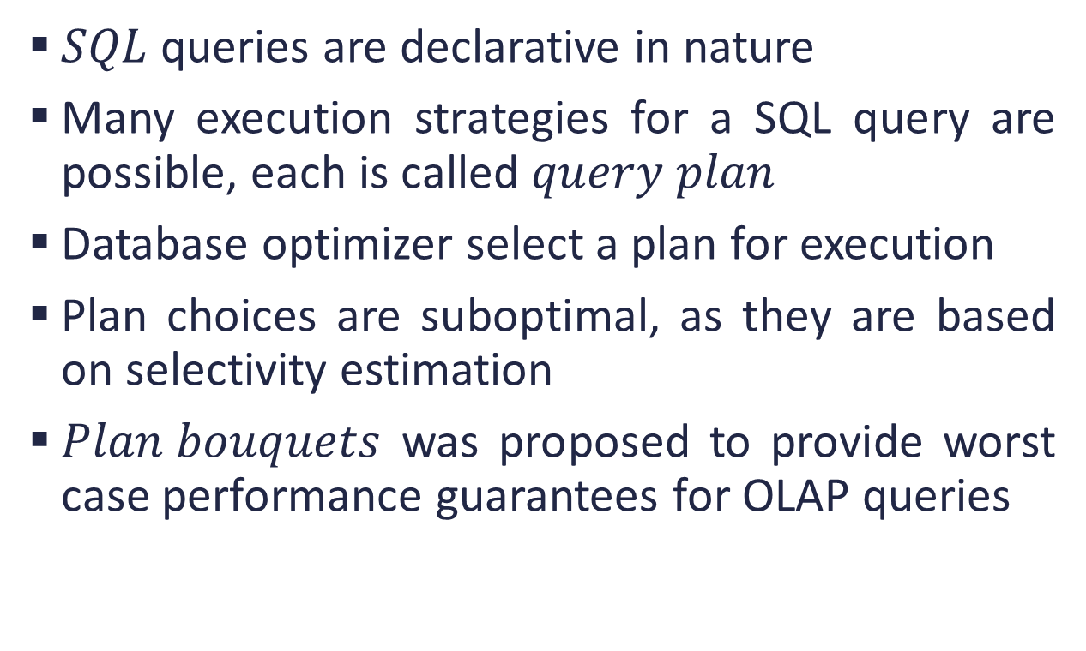
Introduction
$SQL$ queries are declarative in nature
Many execution strategies for a SQL query are possible, each is called $query plan$
Database optimizer select a plan for execution
Plan choices are suboptimal, as they are based on selectivity estimation
$Plan bouquets$ was proposed to provide worst case performance guarantees for OLAP queries

Slide 3
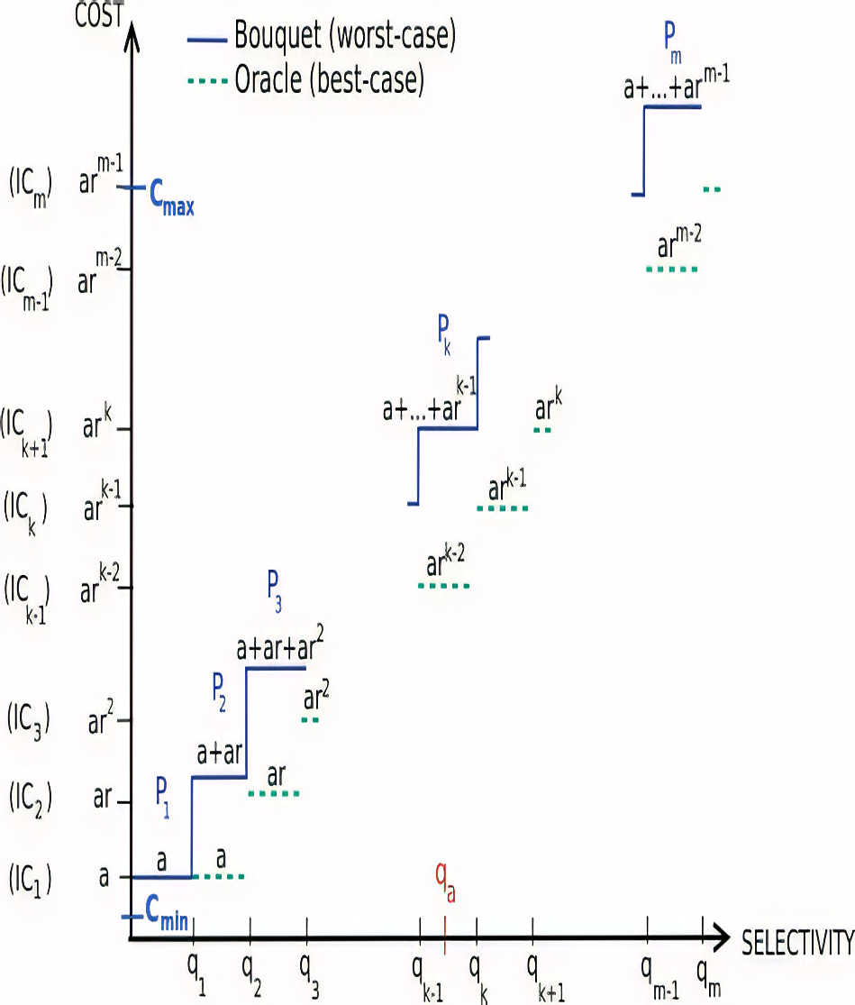
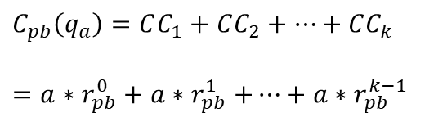
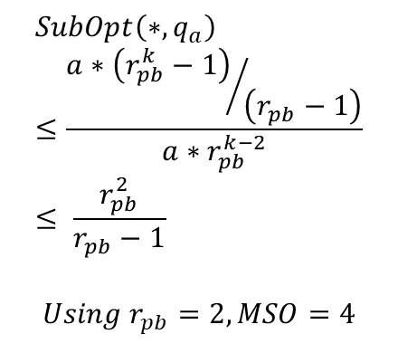
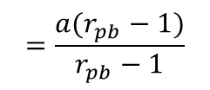
Plan Bouquets
$C_{pb}\left(q_{a}\right)=CC_{1}+$ $CC_{2}+…+CC_{k}$
$=a{∗r}_{pb}^{0}+$ $a{∗r}_{pb}^{1}+…+a{∗r}_{pb}^{k−1}$
$$=\frac{a(r_{pb}−1)}{r_{pb}−1}$$
$$SubOpt\left(∗,q_{a}\right)≤\frac{{a∗\left(r_{pb}^{k}−1\right)}/{\left(r_{pb}−1\right)}}{a∗r_{pb}^{k−2}}≤ \frac{r_{pb}^{2}}{r_{pb}−1}$$
$$Using r_{pb}=2, MSO=4$$

Slide 4
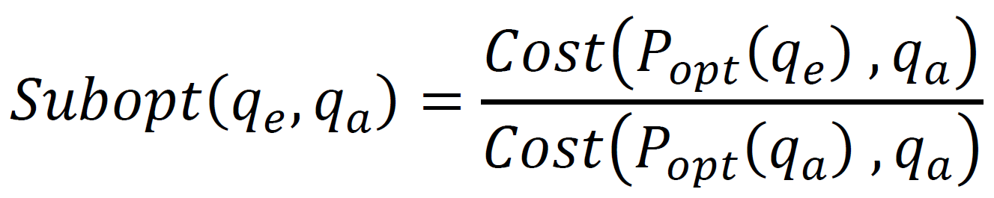
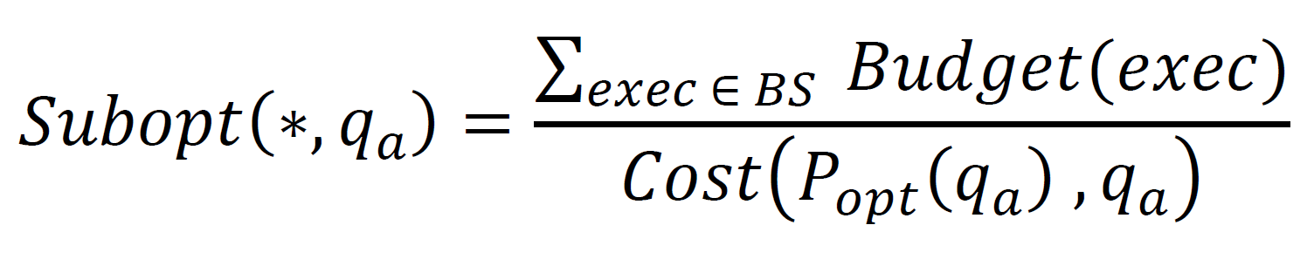
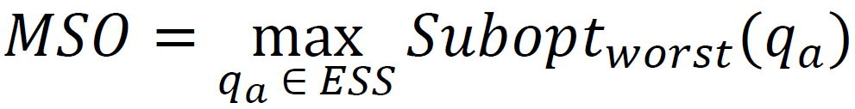
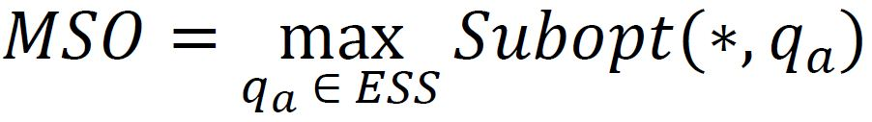
Performance Metrics
Suboptimality
Worst Suboptimality
Maximum Suboptimality (MSO)

Slide 5
Assumptions
Plan Cost Monotonicity (PCM)
Axis Parallel Concave (APC)
Perfect Cost Model of Optimizer
Bounded Cost Growth (BCG)
Piece-wise Axis Parallel Linear (APL)
Selectivity Independence

Slide 6
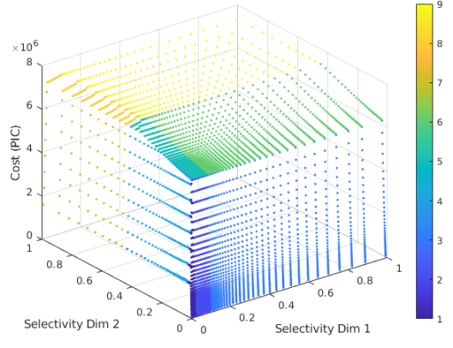
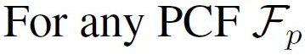
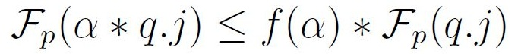
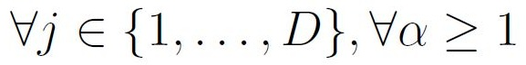
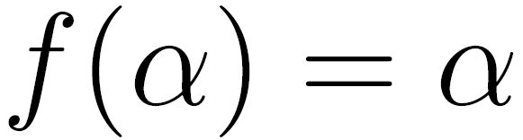
Linearity & BCG of OCS
Common observation is
(a) Exemplar piecewise linear OCS
(b) Definition of BCG
Note: APL and BCG behavior of Plan Cost Functions implies similar behavior of OCS

Slide 7
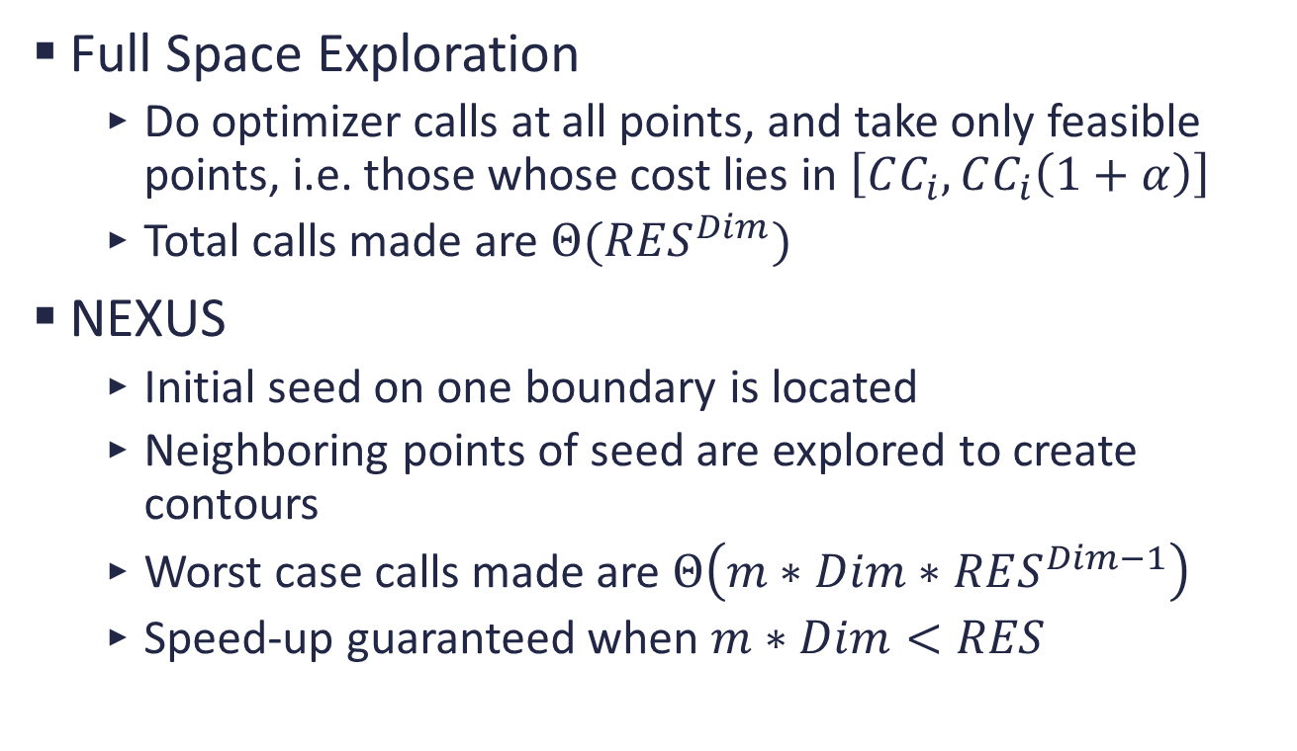
Bouquets Compilation
Full Space Exploration
Do optimizer calls at all points, and take only feasible points, i.e. those whose cost lies in $\left[CC_{i},CC_{i}\left(1+α\right)\right]$
Total calls made are $Θ(RES^{Dim})$
NEXUS
Initial seed on one boundary is located
Neighboring points of seed are explored to create contours
Worst case calls made are $Θ\left(m∗Dim∗RES^{Dim−1}\right)$
Speed-up guaranteed when $m∗Dim<RES$

Slide 8
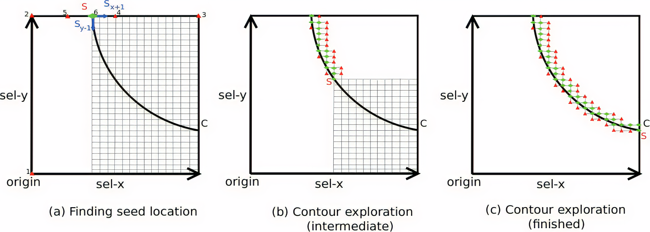
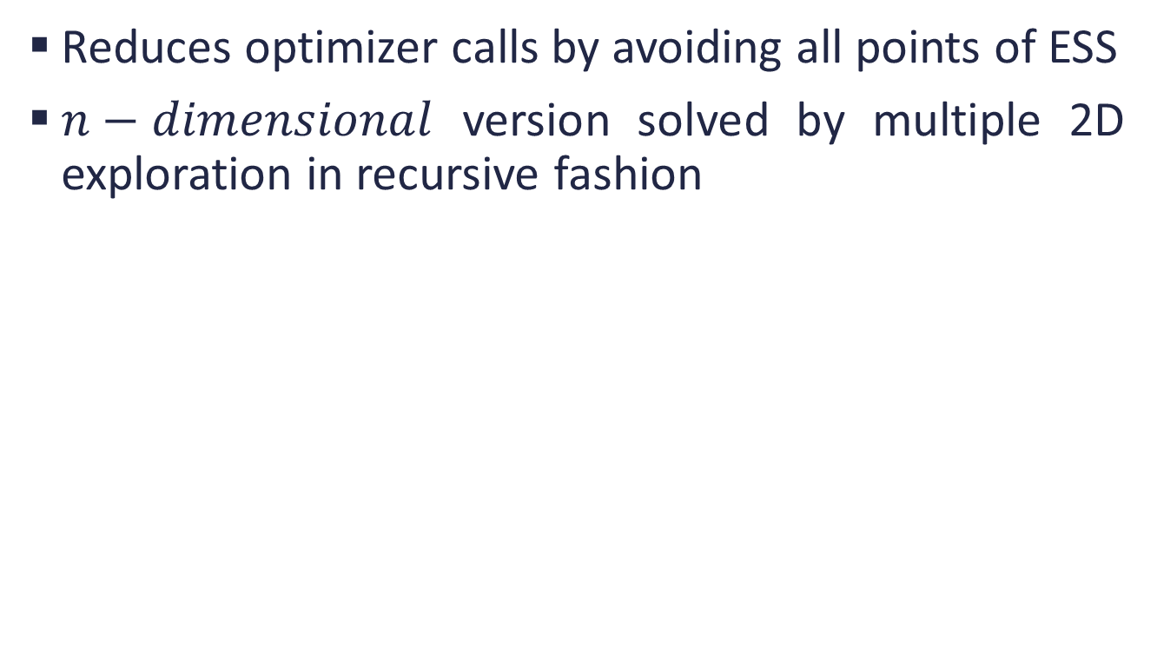
Understanding NEXUS
Reduces optimizer calls by avoiding all points of ESS
$n−dimensional$ version solved by multiple 2D exploration in recursive fashion

Slide 9
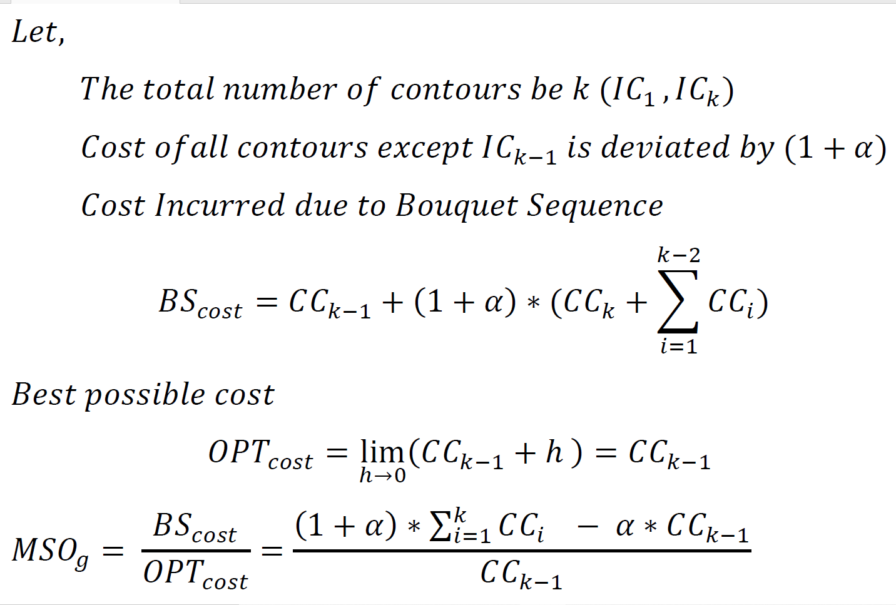

$MSO_{g}$ on Cost Deviation

Slide 10
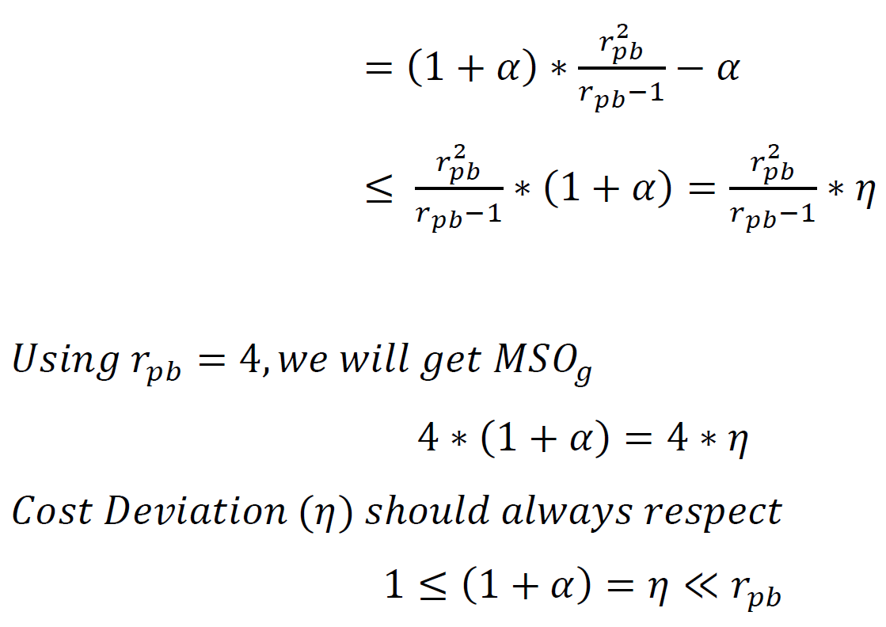

Slide 11
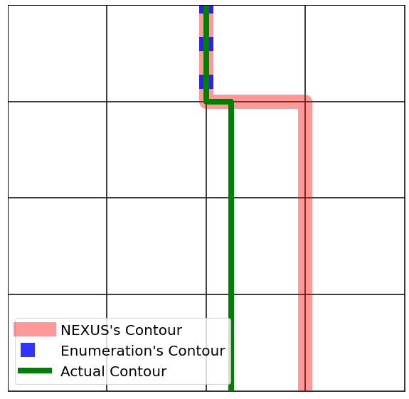
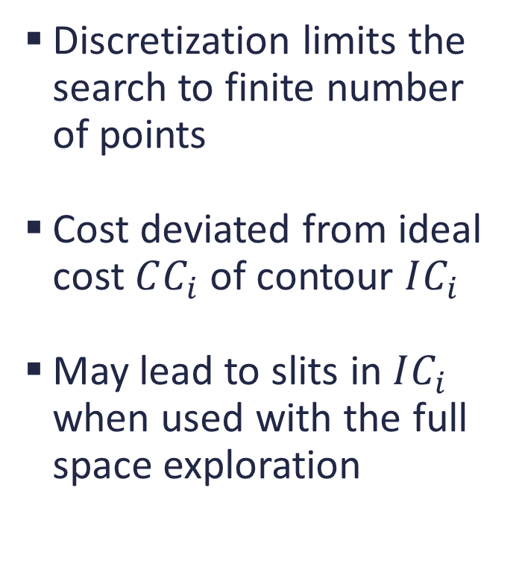
Cons of existing methods
Discretization limits the search to finite number of points
Cost deviated from ideal cost $CC_{i}$ of contour $IC_{i}$
May lead to slits in $IC_{i}$ when used with the full space exploration

Slide 12
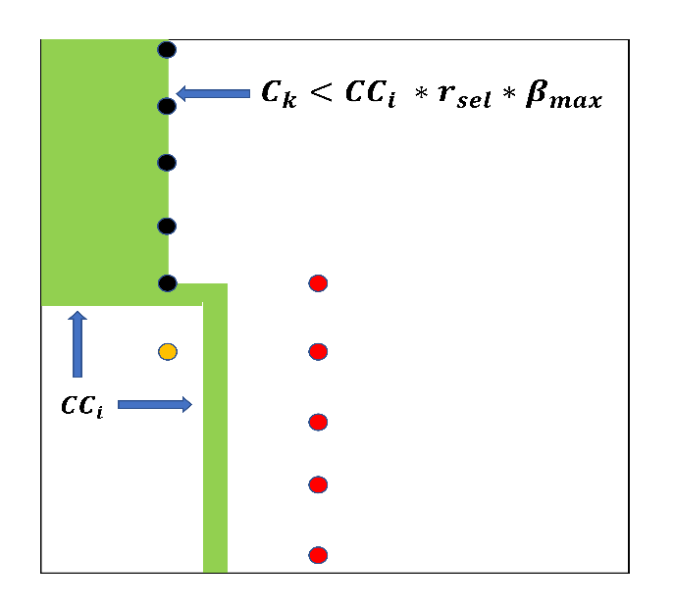

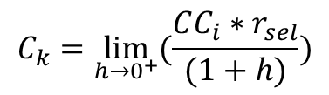
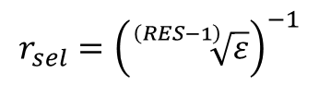

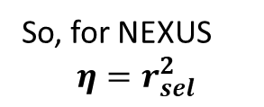

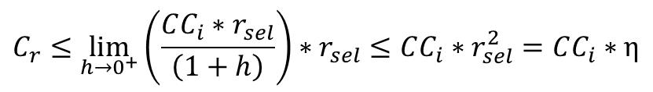
NEXUS Cost Deviation
Assume $β_{max} = 1$ in BCG assumption, $r_{sel}$ is the ratio to discretize ESS, $r_{cost}$ is cost ratio change per step in ESS
$$r_{cost}≤r_{sel}$$
$$r_{sel}={\left(\sqrt[\left(RES−1\right)]{ε}\right)}^{−1}$$
Black points have cost $C_{k}$, where
$$C_{k}=\lim_{h→0^{+}}{(\frac{CC_{i}∗r_{sel}}{(1+h)})}$$
Yellow point have cost < $CC_{i}$, in that case Blind-search of NEXUS will choose a next red point now
Cost of red point be $C_{r}$, where $C_{r}$ due to BCG is
$$C_{r}≤\lim_{h→0^{+}}\left(\frac{CC_{i}∗r_{sel}}{\left(1+h\right)}\right)∗r_{sel}≤CC_{i}∗r_{sel}^{2}=CC_{i}∗η$$
So, for NEXUS
$$η=r_{sel}^{2}$$

Slide 13
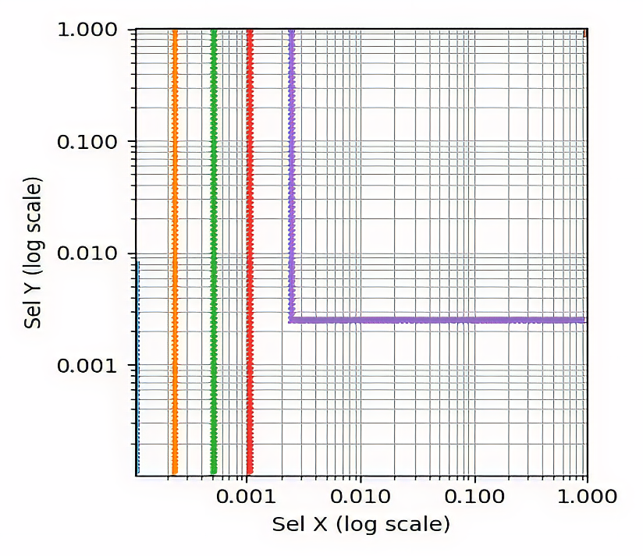
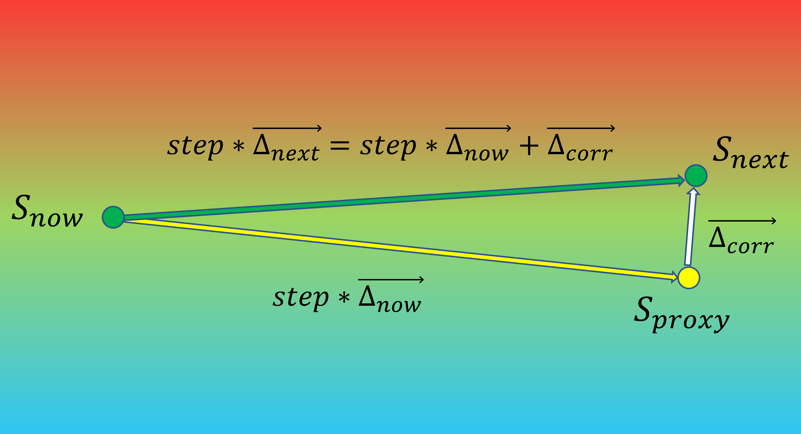
AdaNEXUS
Piece-wise linear contours are observed in practice
Step sizes during contour discovery can be increased exponentially when the further points are in a desired cost interval
When the next given direction is wrong, aggressive search finds it

Slide 14
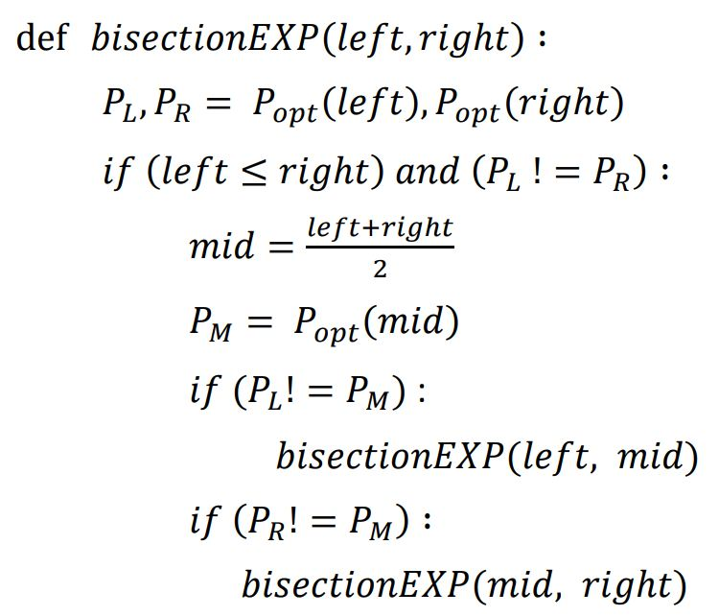
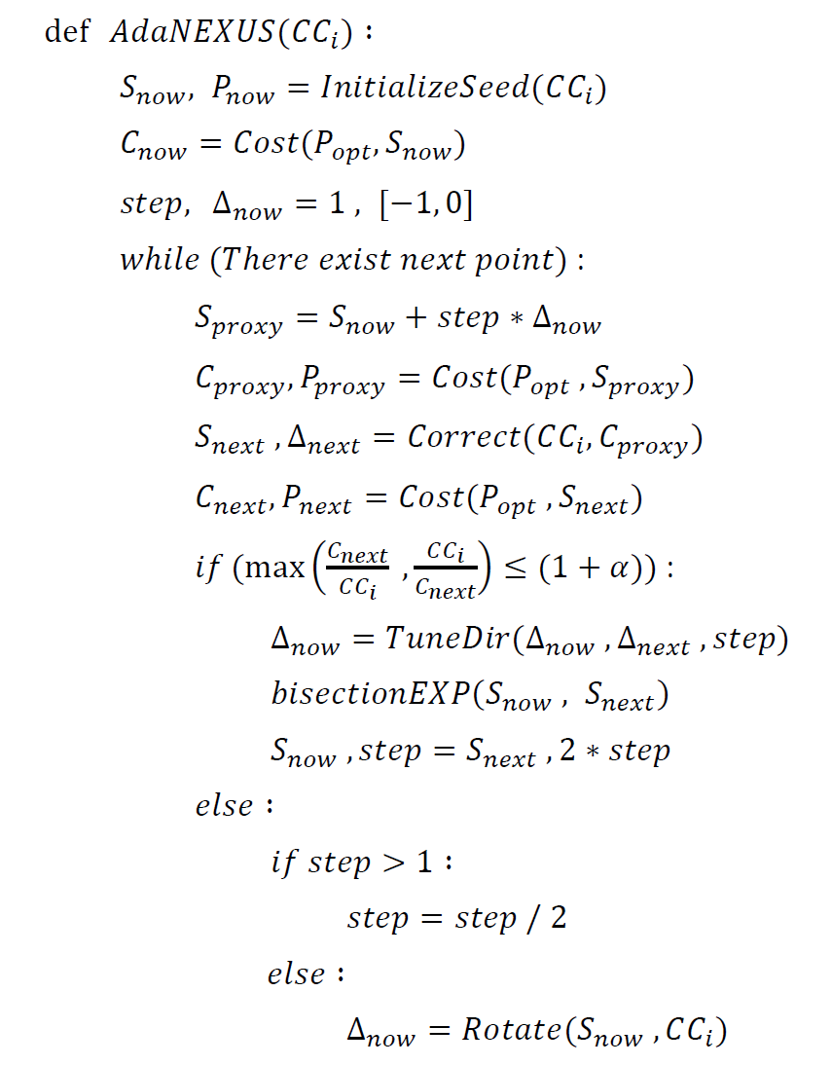
AdaNEXUS

Slide 15
Experiments
Database Environment
Evaluation on 8 TPC-DS SQL queries
Dimension of ESS from 3 to 5
DB instances in range of 1GB to 250GB via CODD
FPC module is used for Foreign Plan Costing
System Environment
DB engine is modified version of Postgres-9.4
Intel© Core™ i9 CPU, 32GB 2666MHz RAM, 2TB Storage

Slide 16
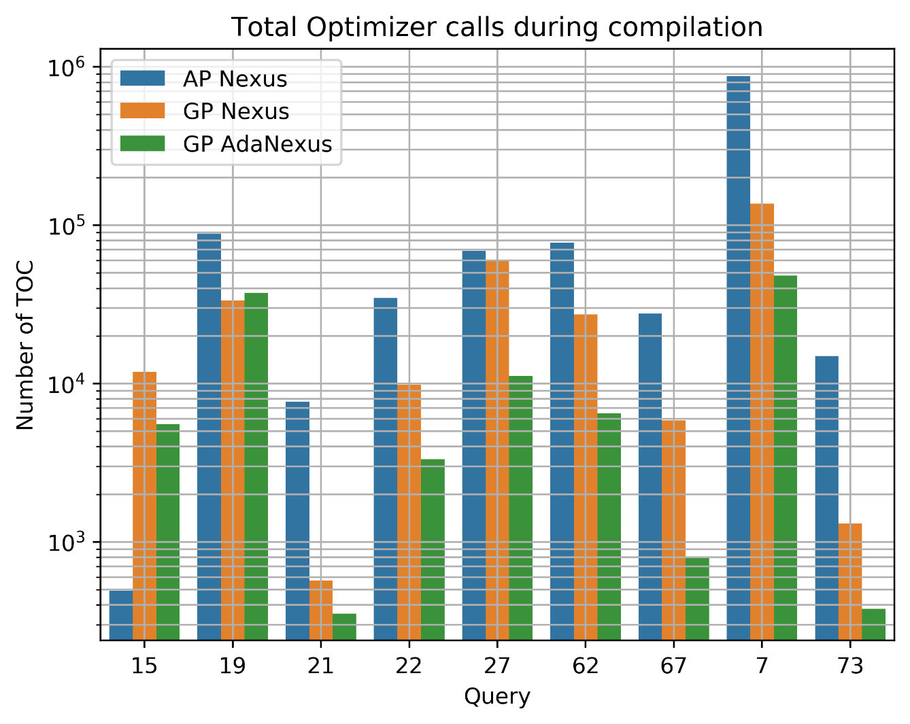
Lesser Optimizer Calls

Slide 17
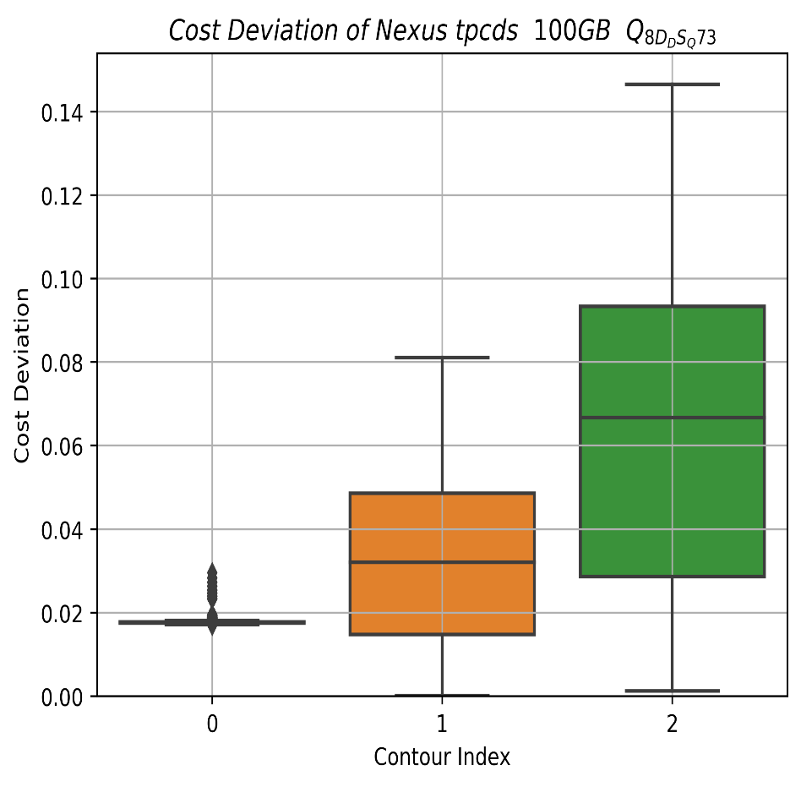
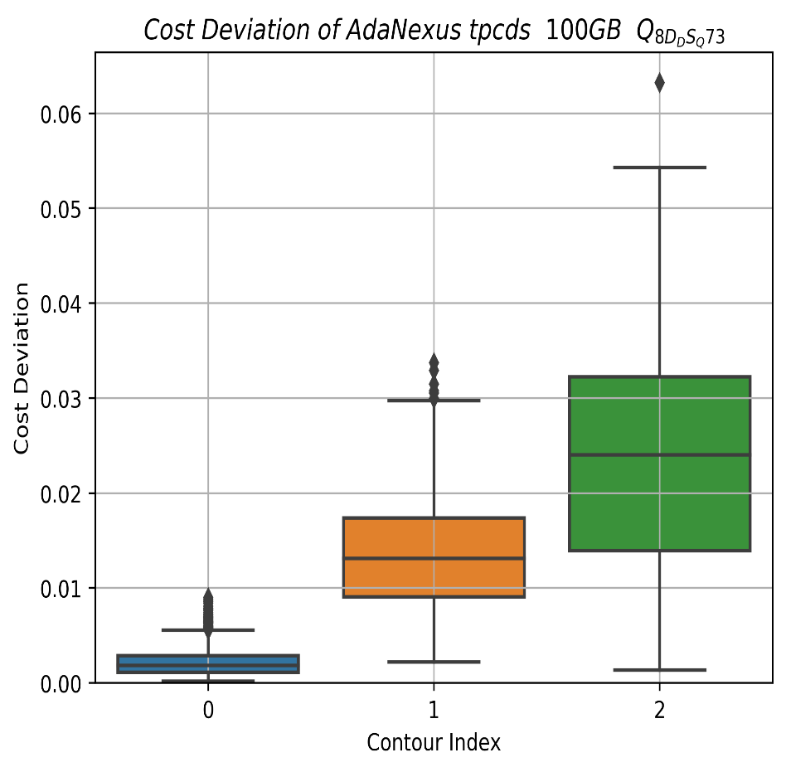
Reduced Cost Deviation
Query 73 100GB instance

Slide 18
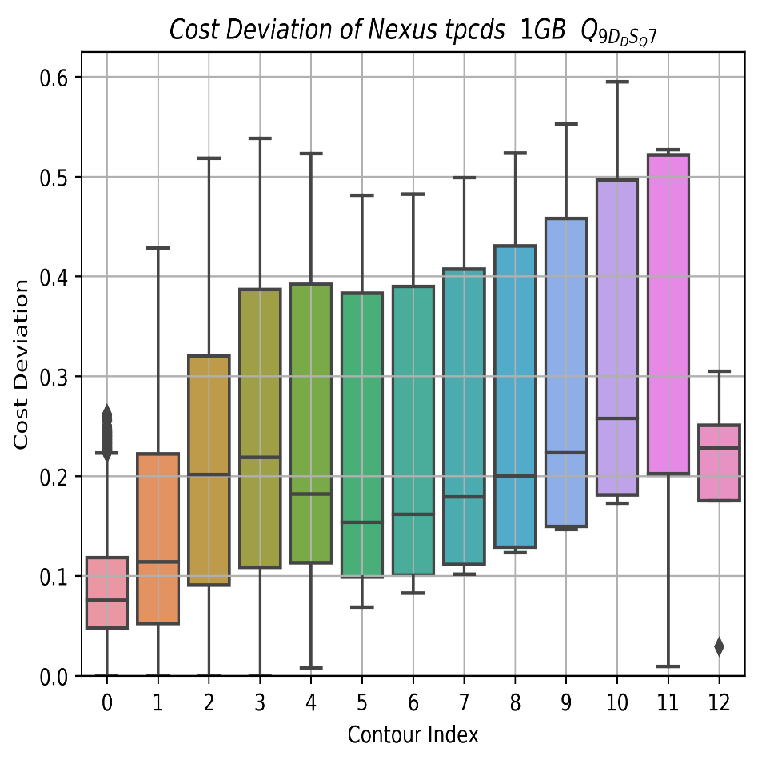
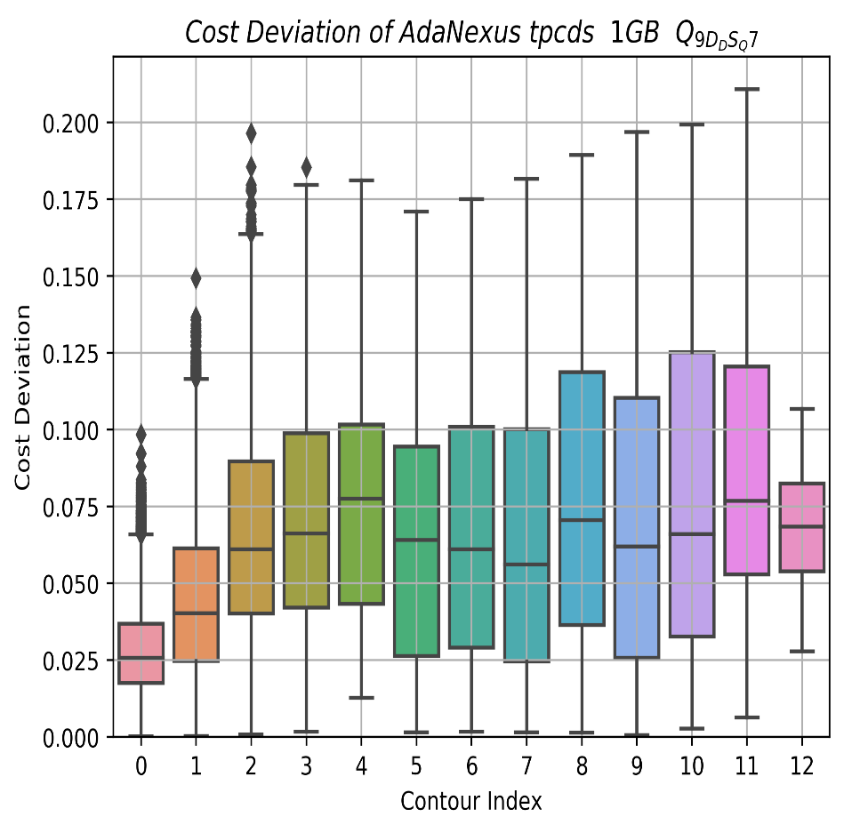
Reduced Cost Deviation
Query 7 1GB instance

Slide 19
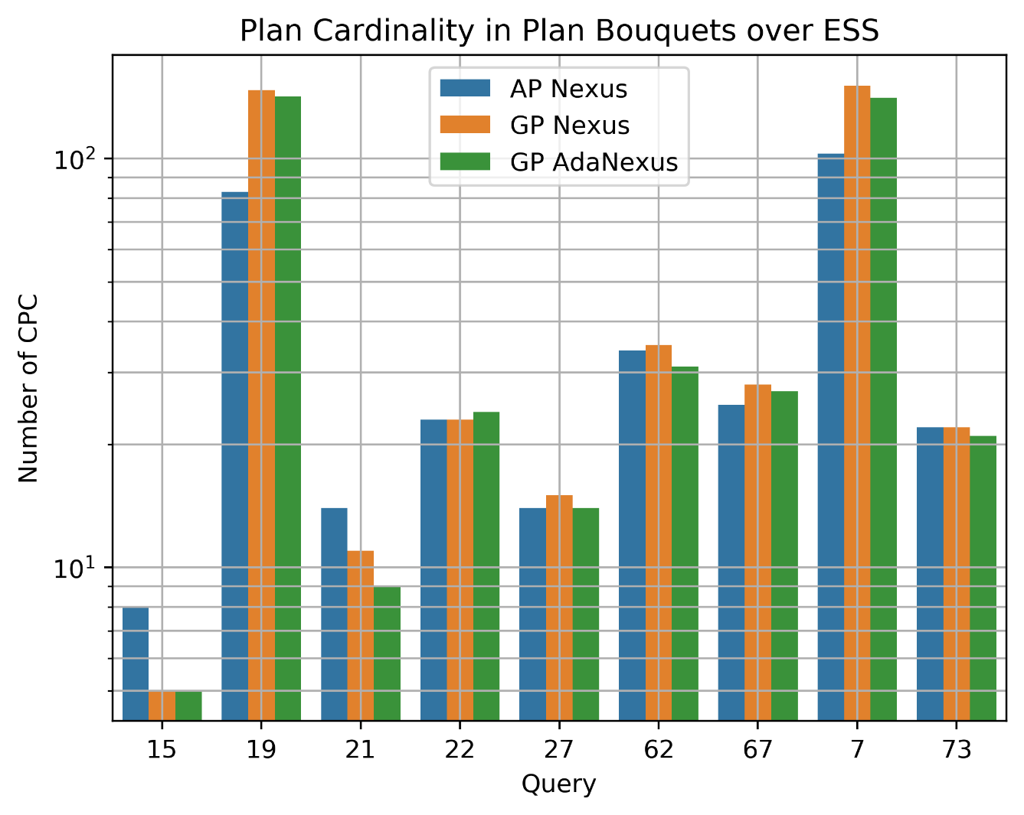
Plan Cardinalities

Slide 20
Conclusion & Future Work
Discretization of ESS is now removed in AdaNEXUS.
Exponentially varying step size leads to bounded cost deviation.
Speed up in contour discovery is obtained (with lesser cost deviation) by using slope information of piece-wise linear contours
Adjacent sub-problems can share information for further speed-up for constructing a contour.
Direction of contour discovery can be tuned using a full learnable PID controller or any (robust and interpretable) machine learning model.

Slide 21
Thank You!

